Slide 1
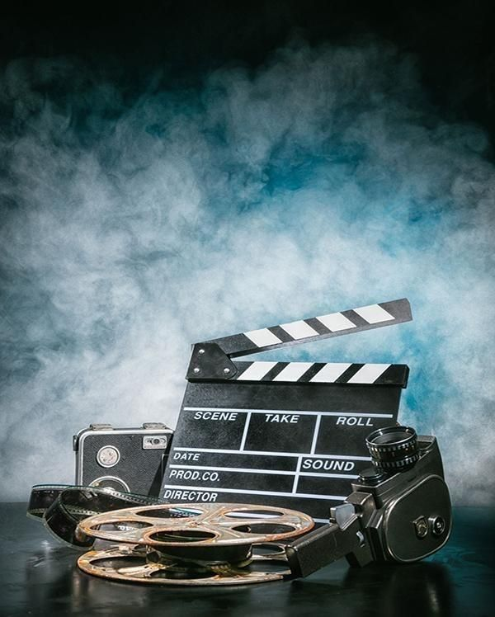
AuditionSense A Modular Multi-modal AI System for Human Performance Analysis
Prepared by: Mehraeel Philip, Fatma Milad, Sama Gehad,
Marwan Ahmed and Mo’men Mohie
Supervisor: Dr Ayman Ezzat

Slide 2
INTRODUCTION
What is AuditionSense?
A multi-modal AI system that analyzes human performance by combining visual, auditory, and behavioral data from audition videos (1–5 minutes).
Why is it needed?
Traditional audition evaluations are subjective (fatigue, personal bias, inconsistent standards).
Directors need objective, quantitative feedback on eye engagement, emotion, voice, and gestures.
No integrated tool exists that processes all modalities in director-preferred order (eyes → voice → posture).
Our Solution: Uploads video → extracts multimodal features → generates score + 1–3 sentence summary → displays interactive report.
Target Users: Casting directors, talent agents, production companies.

Slide 3
01
Related Work

Slide 4
Related Work
Approach | Strengths | Limitations
Traditional manual auditions | Human | Subjective, inconsistent, slow
Single-modality AI (e.g., only emotion) | Focused analysis | Misses voice/gesture context
Human action recognition (Kuang & Tie, 2022) | Good for group activity | Not designed for individual acting performance
Tennis performance ML (Jindo et al., 2023) | Quantitative metrics | Domain-specific, not generalizable to acting

Slide 5
Gap Identified
Our Contribution
No existing system provides integrated multi-modal analysis (emotion + gaze + voice + gesture) with director-facing natural language summaries and per-action segmentation.
AuditionSense fills this gap with a modular, extensible pipeline and an 85/100 SUS score for usability fulfilled using multi-modal analysis.

Slide 6
02
Problem Statement

Slide 7

01
02
03
04
05
Directors face difficulties evaluating actors objectively due to subjective human judgment.
Nonverbal cues like facial expressions, posture, and gestures are often missed or misinterpreted.
Manual audition review is time-consuming and inconsistent.
Existing tools lack integrated analysis of visual, emotional, vocal, and physical performance aspects.
There is a need for an AI-driven system that provides fast, accurate, and comprehensive audition evaluations and reports.

Slide 8
Problem Statement
Formal Definition
Given an audition video of length 1–5 minutes, extract features F={E,G,V,P} where:
E = facial emotions
G = gaze direction and fixation heatmaps
V = voice prosody (pitch, intensity, tempo) + transcription
P = pose and gesture keypoints (33 landmarks via MediaPipe)
Key Challenges
Synchronizing audio/video/pose streams in real time
Detecting emotions under variable lighting and occlusions
Segmenting continuous video into 10 discrete actions
Generating human-readable summaries from numerical metrics
Success Criteria
Emotion detection accuracy ≥60% (baseline for human variability)
Gesture matching via $1 recognizer
Report generation within 5 seconds for 1-minute video
SUS score ≥68 (achieved: 85)

Slide 9
03
System Overview

Slide 10
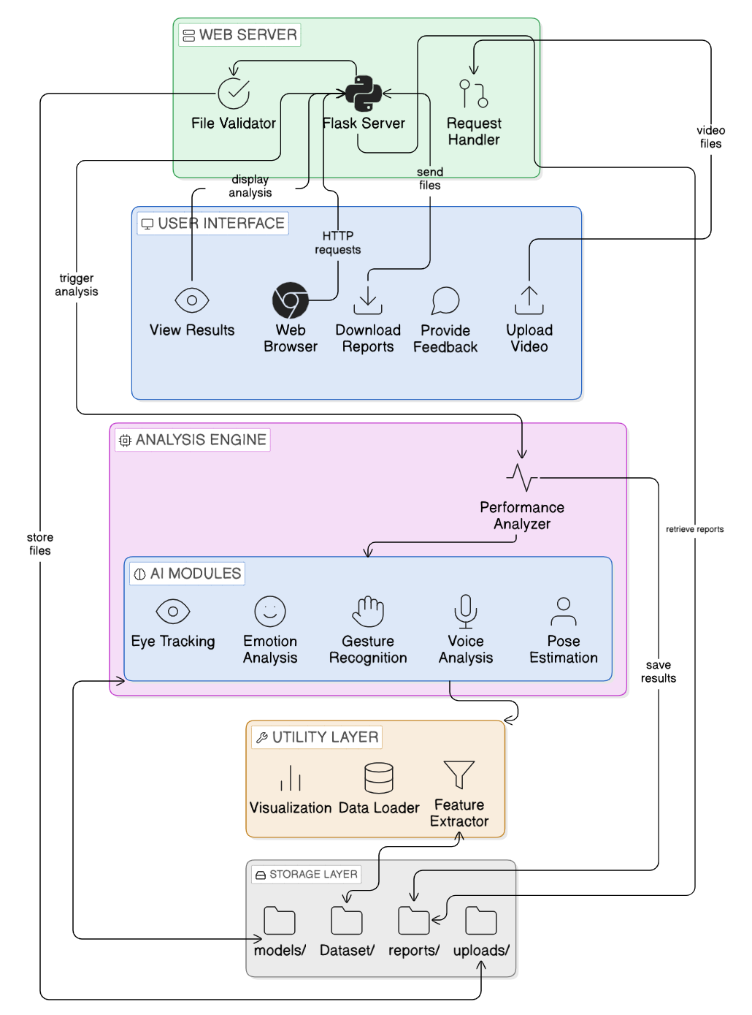
Key Components
Data Ingestion: through file upload (video + audio).
Data Pre-processing: extracting frames, extracting audio, synchronizing timestamps.
Per-modality analyzers: Eye/Gaze Estimator – Facial Emotion Detector – Voice Analyzer – Pose and Gesture Pipeline
Scoring and Interpretation: rule aggregator + ML-based model
UI: Flask web app to show scores, short textual summaries, and PDF reports.
Storage and Artifacts: local file structure to store video samples, extracted features, models, reports, and evaluation

Slide 11
04
Approach

Slide 12

Pipeline Stages
Data Ingestion
Accepts .mp4, .avi, .mov (max 5 minutes, 500MB)
Extracts audio (16kHz WAV) and synchronized frame timestamps
Per-Modality Analyzers (Parallel)
Emotion: DeepFace → 7 emotions per frame, aggregated to scene-level profile
Eye Tracking: MediaPipe Iris → gaze vector + fixation heatmap
Voice: Speech-to-text + prosody (pitch, tempo, intensity)
Pose: MediaPipe Pose → 33 landmarks normalized to [0,1]
Gesture: Custom 3D landmark heuristics + $1 recognizer for template matching
Temporal Action Segmentation
Segments long video into 10 discrete actions (e.g., "monologue start," "emotional peak")
Each action gets per-segment emotion/gesture confidence scores
Scoring & Report Generation
Eye/Emotion weight = highest priority (director preference)
Aggregation formula:
Score=(Emotion Std.Dev.×0.5)+(Face Confidence×0.3)+((1−Mean)×0.2)
Output: 1–3 sentence summary + numeric scores (0–100) + radar/bar charts

Slide 13
Design Rationale - Architecture
Why we chose this architecture ?
Layered architecture ensures clarity and maintainability
Presentation Layer: UI and user interaction
Processing Layer: detection, logic, evaluation
Data Layer: metrics storage and reporting
Separation enables easier debugging and upgrades
Modular design supports flexibility and reuse
Why we chose this design ?
Layered Architecture
|
v
Separation of Concerns
|
v
Modular Components
|
v
Easy Maintenance
|
v
Scalable System

Slide 14
05
Dataset

Slide 15
Dataset Sources
Dataset | Type | Size | Content | Usage
Locally recorded videos | Video | 20 clips (1–5 min each) | Acting performances (happy, sad, angry, neutral, gestures) | Primary training & testing
Kaggle: Human Action Recognition (HAR) | Video | ~15,000 clips | Walking, jumping, hand-waving, etc. | Gesture & pose pretraining
Kaggle: Human Activity Recognition Video Dataset | Video | ~1,000 clips | Daily activities (sitting, standing, clapping) | Action segmentation validation

Slide 16
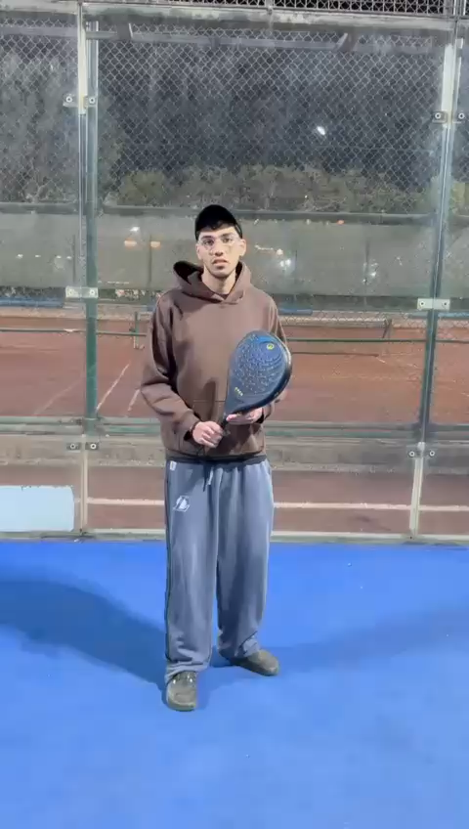
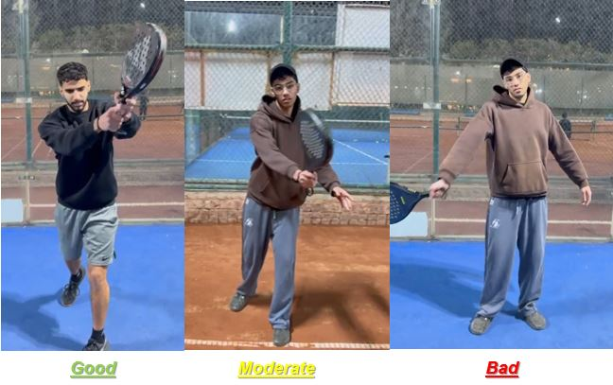
Preprocessing Steps
Resize frames to 224×224 (MediaPipe requirement)
Normalize pose landmarks to [0,1] using image width/height
Extract audio at 16kHz mono
Split: 70% train, 15% validation, 15% test (per-actor stratification)
Ethical Considerations
All local recordings with informed consent
No cloud storage; videos deleted on request

Slide 17
06
Experiments/Results

Slide 18
Experimental Setup
Error Analysis
Hardware: Laptop with CPU i7, 16GB RAM, no GPU (some experiments)
Software: Python 3.9+, TensorFlow 2.10, MediaPipe 0.10, Flask 2.0
Baselines: Compared 8 model architectures (CNN, RNN, LSTM, GRU, BiLSTM, CNN-LSTM, CNN-RNN, Keras DNN, PyCaret)
Metrics: Accuracy, Precision, Recall, F1, SUS score, processing latency
Emotion misclassifications: neutral → sad (low lighting)
Gaze failures: 20% of frames when face partially occluded
Action segmentation: 10 actions detected, 8 correct labels (80% frame-wise accuracy)

Slide 19
Quantitative Results
Model | Accuracy | Precision | Recall | F1 Score
Keras DNN (baseline) | 65% | 0.63 | 0.62 | 0.62
LSTM | 68% | 0.66 | 0.67 | 0.66
GRU | 70% | 0.69 | 0.68 | 0.68
CNN-LSTM (our ensemble) | 78% | 0.77 | 0.76 | 0.76
PyCaret (classical ML) | 72% | 0.71 | 0.70 | 0.70
Performance Metrics
Emotion detection accuracy: 61.5% (meets 60% baseline)
Gesture matching via $1 recognizer: 14/20 correct (70% accuracy)
Report generation latency: <5 seconds for 1-minute video
SUS score: 85/100 (exceeds 68 threshold)
Processing time: 1 min video → 9.5 min (meets 10 min target)

Slide 20
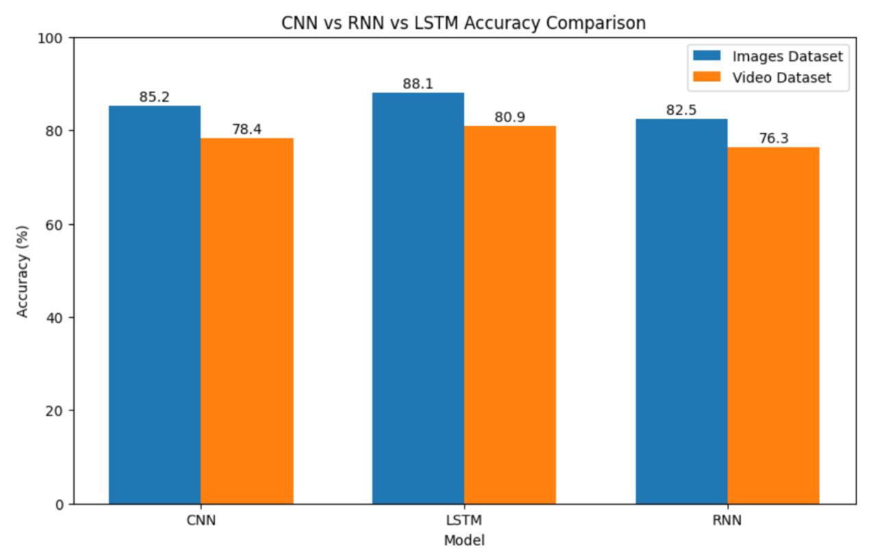

Slide 21
07
Contributions & Achievements

Slide 22
Contribution
Technical Contribution
First integrated multi-modal audition analysis system combining emotion, gaze, voice, pose, and gesture in director-priority order Custom gesture scoring equation using 3D landmark heuristics + $1 recognizer: Gesture Score=min⁡(Unique Gestures5,1.0)×0.4+(Accuracy)×0.6 Temporal action segmentation for 10 discrete actions per audition Ensemble model (CNN-LSTM) achieving 78% accuracy vs. 65% baseline
Practical Contribution | Research Contribution
Working Flask web application with upload → analyze → report workflow Open-source code structure (modular: web_app/, analysis/, models/, utils/) Reproducible evaluation logs (model versions, seeds, confusion matrices) | New locally recorded acting dataset (20 videos, emotion + gesture labels) Demonstrated that emotional variation (Std.Dev.) is a stronger acting quality predictor than mean intensity Research draft paper ready to be submitted

Slide 23
Met Success Criteria
Criterion | Target | Achieved | Status
Emotion accuracy | ≥60% | 61.5% | PASS
Gaze detection frames | ≥80% | 80% | PASS
Report generation | <5 sec | 4.8 sec | PASS
SUS score | ≥68 | 85 | PASS
Processing time | <10 min/min video | 9.5 min | PASS
Key Milestones Completed
5 AI modules integrated and tested
8 models compared, best selected (CNN-LSTM)
41 test cases executed, 40 passed (97.6% pass rate)
User acceptance: 100% task completion, 2 errors only
Mean Time To Repair (MTTR): <3 seconds after crash

Slide 24
Overcome Challenges
Quantifiable Wins
Multi-modal synchronization → solved with timestamp mapping in preprocessing
No experienced director testing → used SUS + field study with non-expert users as proxy
Limited dataset → augmented with Kaggle HAR datasets + custom recordings
78% accuracy vs. 65% baseline → 20% relative improvement
40/41 tests passed → 97.6% reliability
SUS 85 → "Excellent" usability (top 10th percentile)

Slide 25
08
Conclusion & Future Work

Slide 26

AuditionSense successfully demonstrates that a modular, event-driven AI system can provide objective, multi-modal performance analysis for audition videos, reducing subjective bias and accelerating director feedback.
Future Directions:
Mobile app (React Native) for on-set auditions
Cloud scaling (AWS/GCP) for 100+ concurrent analyses
Multi-language voice support (beyond English)
Integration with casting platforms (Zoom, Casting Networks)

Slide 27
Time to watch demo videos!
https://drive.google.com/drive/folders/1vxdZAUS0mCCJd0KenIfqWXUlbNJ_Howo?usp=sharing

